Slide 1

Maven with Selenium-Part 2

Slide 2
Introduction
Maven is used to define project structure, dependencies, build, and test management.
Using pom.xml(Maven) you can configure dependencies needed for building testing and running code.
Maven automatically downloads the necessary files from the repository while building the project.

Slide 3
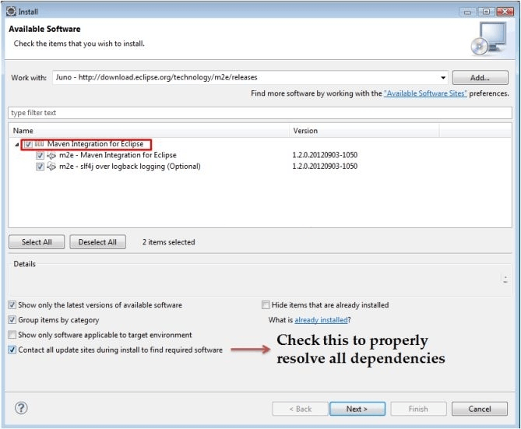
Procedure of Maven Installation and using with TestNG Selenium
Step1) In Eclipse IDE, select Help | Install New Software from Eclipse Main Menu.
Step 2) On the Install dialog, select Work with and m2e plugin as shown in the following-g screenshot:
Step 3) Click on Next button and finish installation.

Slide 4
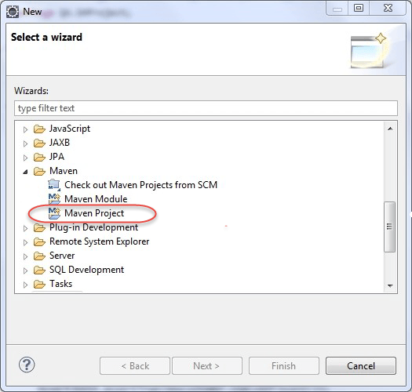
Configure Eclipse with Maven:-With m2e plugin is installed, now need to create Maven project.
Step 1) In Eclipse IDE, create a new project by selecting File | New | Other from Eclipse menu.
Step 2) On the New dialog, select Maven | Maven Project and click Next.

Slide 5
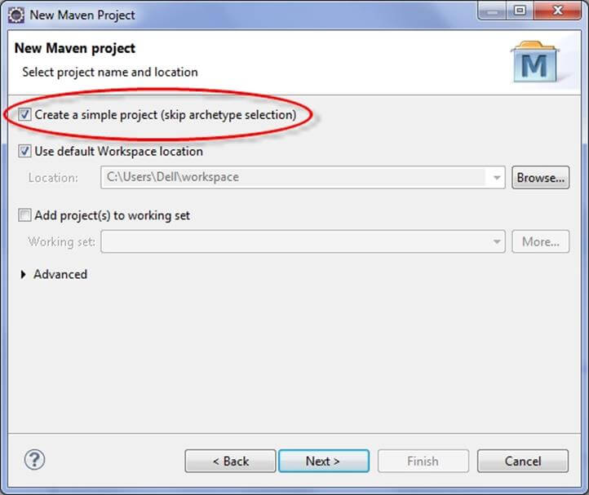
Step 3) On the New Maven Project dialog select the Create a simple project
and click Next

Slide 6
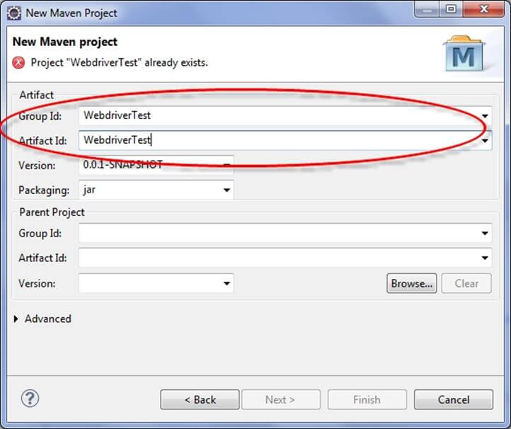
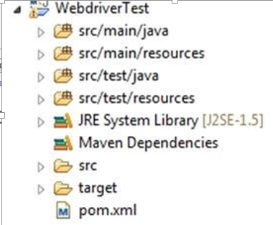
Step 4) Enter WebdriverTest in Group Id and Artifact Id and click finish.
Step 5) Eclipse will create WebdriverTest
with following structure:-

Slide 7
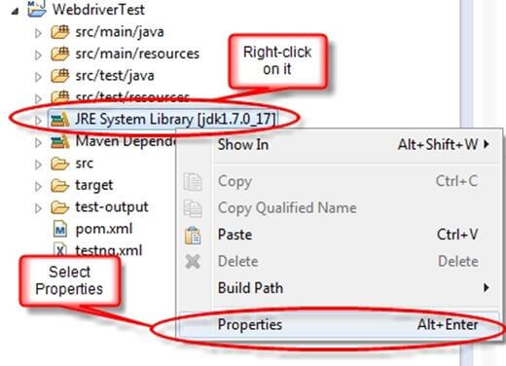
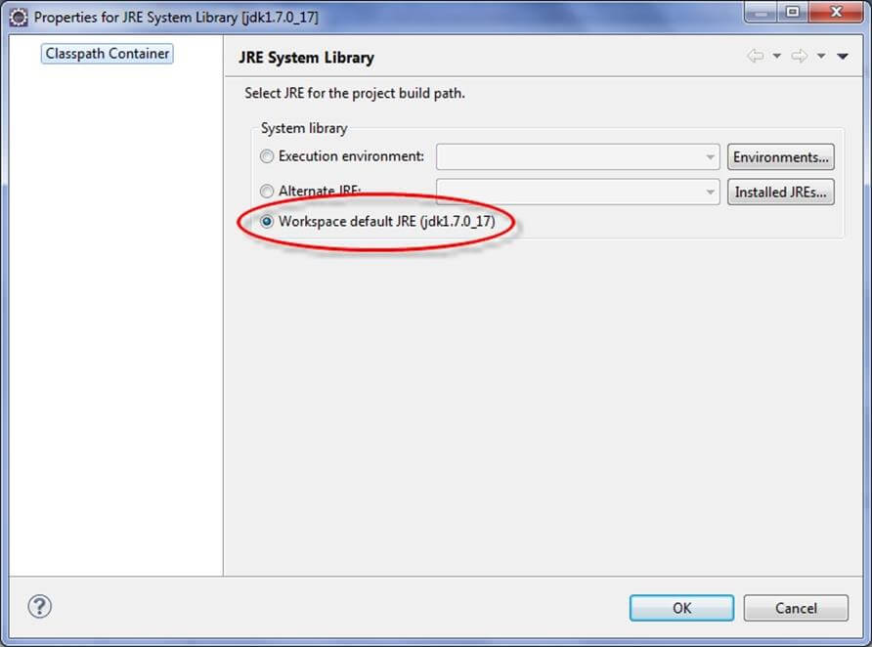
Step 6) Right-click on JRE System Library and select the Properties option
from the menu.
On the Properties for JRE System
Library dialog box, make sure
Workspace default JRE is selected
and click OK

Slide 8
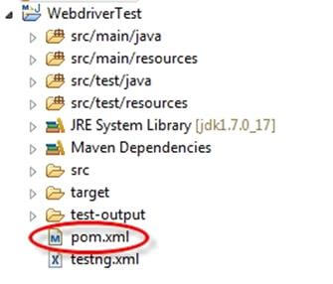
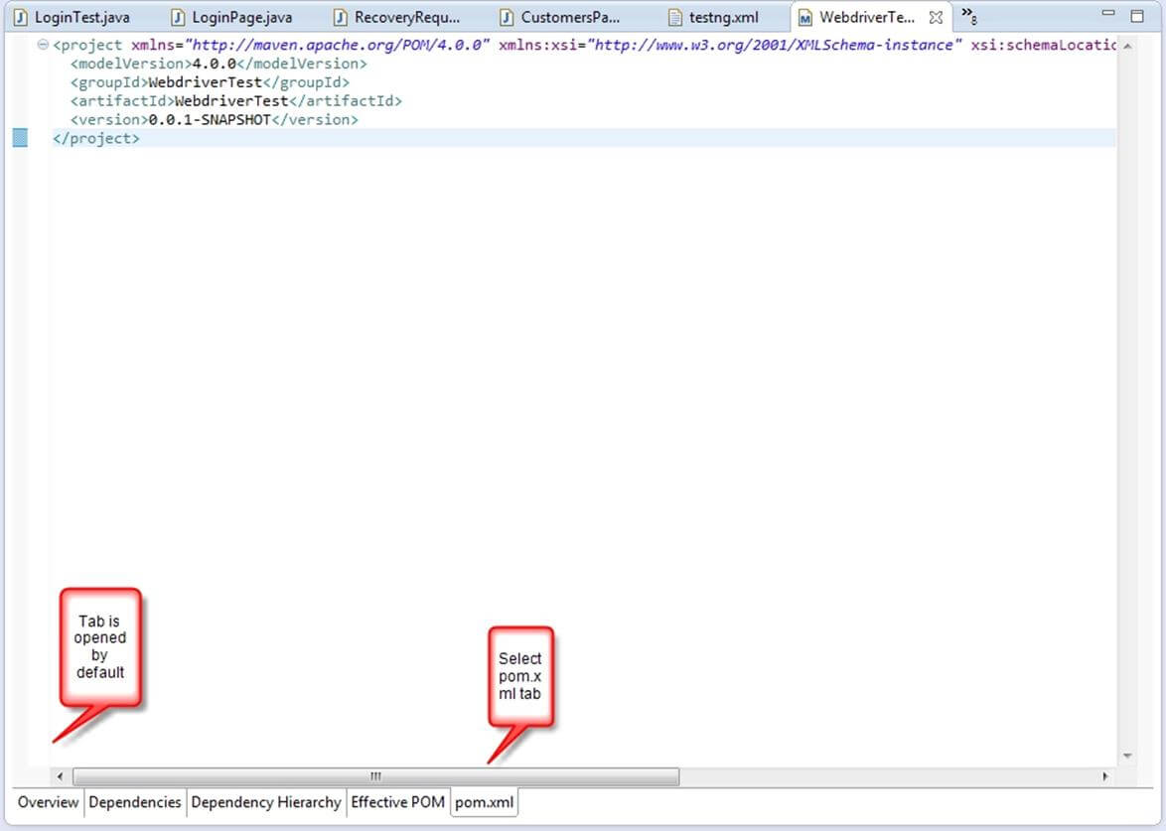
Step 7) Select pom.xml from Project Explorer.
pom.xml file will Open
in Editor section

Slide 9
Step 8) Add the Selenium, Maven, TestNG, Junit dependencies to pom.xml
in the <project> node
<dependencies>
<dependency>
<groupId>junit</groupId>
<artifactId>junit</artifactId>
<version>3.8.1</version>
<scope>test</scope>
</dependency>
<dependency>
<groupId>org.seleniumhq.selenium</groupId>
<artifactId>selenium-java</artifactId>
<version>2.45.0</version>
</dependency>
<dependency>
<groupId>org.testng</groupId>
<artifactId>testng</artifactId>
<version>6.8</version>
<scope>test</scope>
</dependency>
</dependencies>

Slide 10
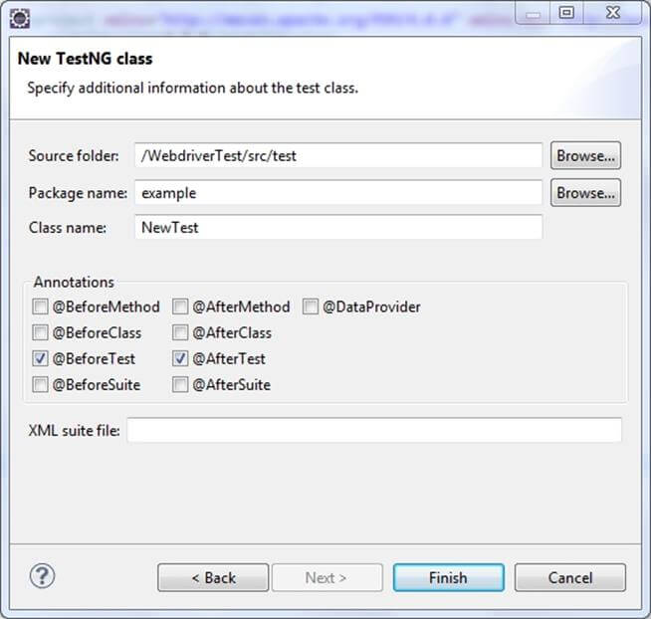
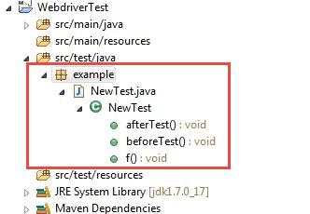
Step 9) Create a New TestNG Class. Enter Package name as "example" and "NewTest" in the Name textbox and click on the Finish button as shown in
the following screenshot:-
Step 10) Eclipse will create the
NewTest class as shown in
the below screenshot:-

Slide 11
package example;
import org.openqa.selenium.By;
import org.openqa.selenium.WebDriver;
import org.openqa.selenium.firefox.FirefoxDriver;
import org.testng.Assert;
import org.testng.annotations.Test;
import org.testng.annotations.BeforeTest;
import org.testng.annotations.AfterTest;
public class NewTest {
private WebDriver driver;
@Test
public void testEasy() {
driver.get(“www.facebook.com");
String title = driver.getTitle();
Assert.assertTrue(title.contains(“Facebook"));
}
@BeforeTest
public void beforeTest() {
driver = new FirefoxDriver();
}
@AfterTest
public void afterTest() {
driver.quit();
}
}
Step 11) Add the following code
to the NewTest class.
This code will verify the title of
Facebook Page.

Slide 12
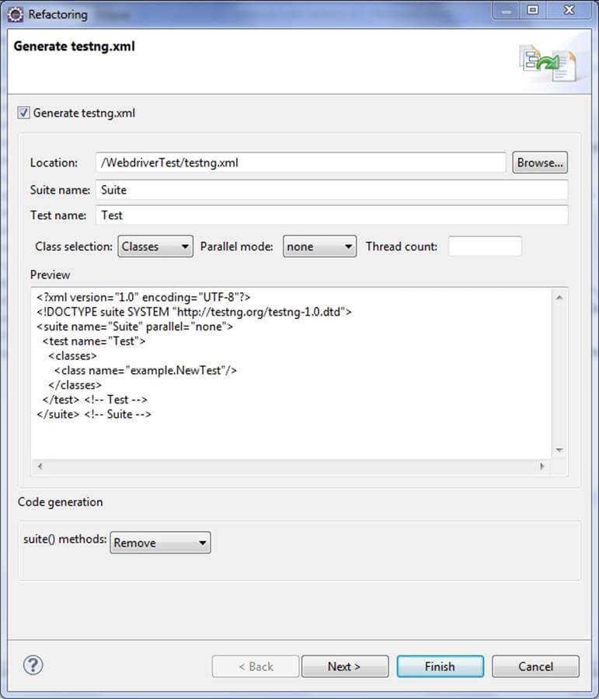
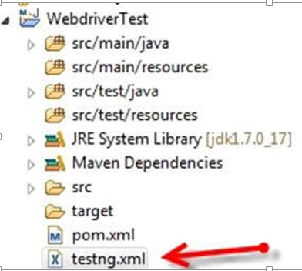
Step 12) Right-click on the WebdriverTest and select TestNG | Convert to
TestNG. Eclipse will create testng.xml which says that need to run only one
test with the name NewTest as shown in the following screenshot:-
Update the project and make sure that
file appears in the tree Package Explorer
(right click on the project - Refresh).

Slide 13
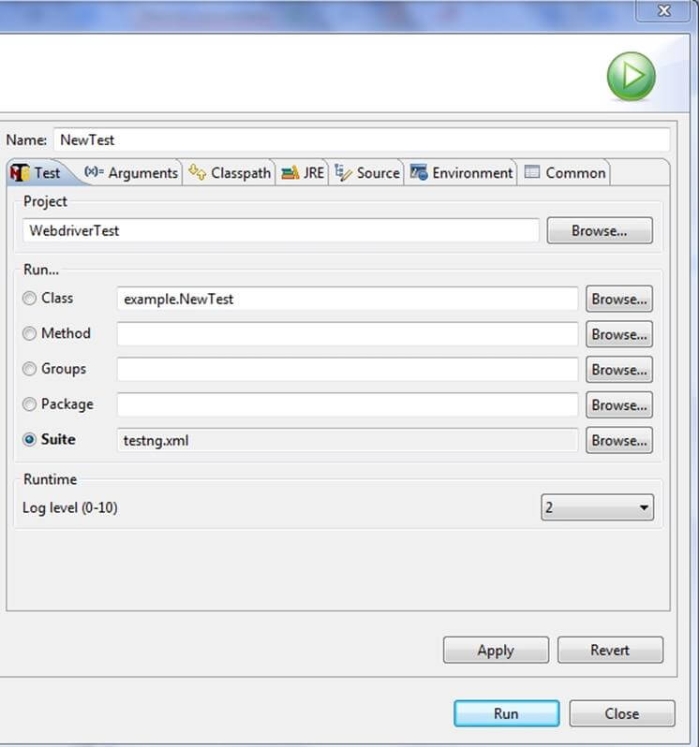
Step 13) Now need to run test through this testng.xml.
go to the Run Configurations and create a new launch TestNG, select the
project and field Suite as testng.xml and click Run.
Make sure that build finished successfully.
Step 14)Now need to add
maven-compiler-plugin,maven-surefire-plugin
,testng.xml to pom.xml.
The maven-surefire-plugin is used to
configure and execute tests.Here plugin is
used to configure the testing.xml for
TestNG test and generate test reports.
The maven-compiler-plugin is used to help in
compiling the code and using the particular
JDK version for compilation.

Slide 14
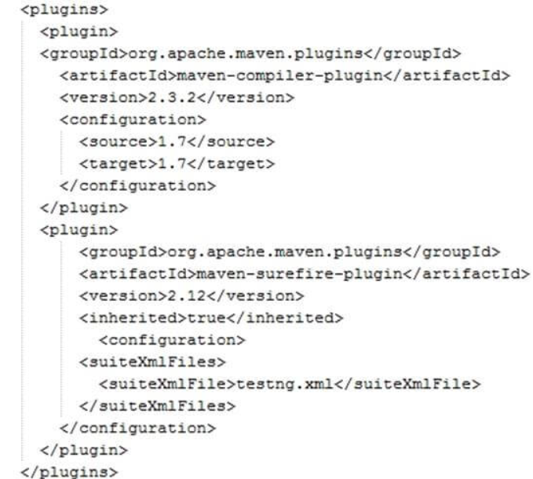

Slide 15
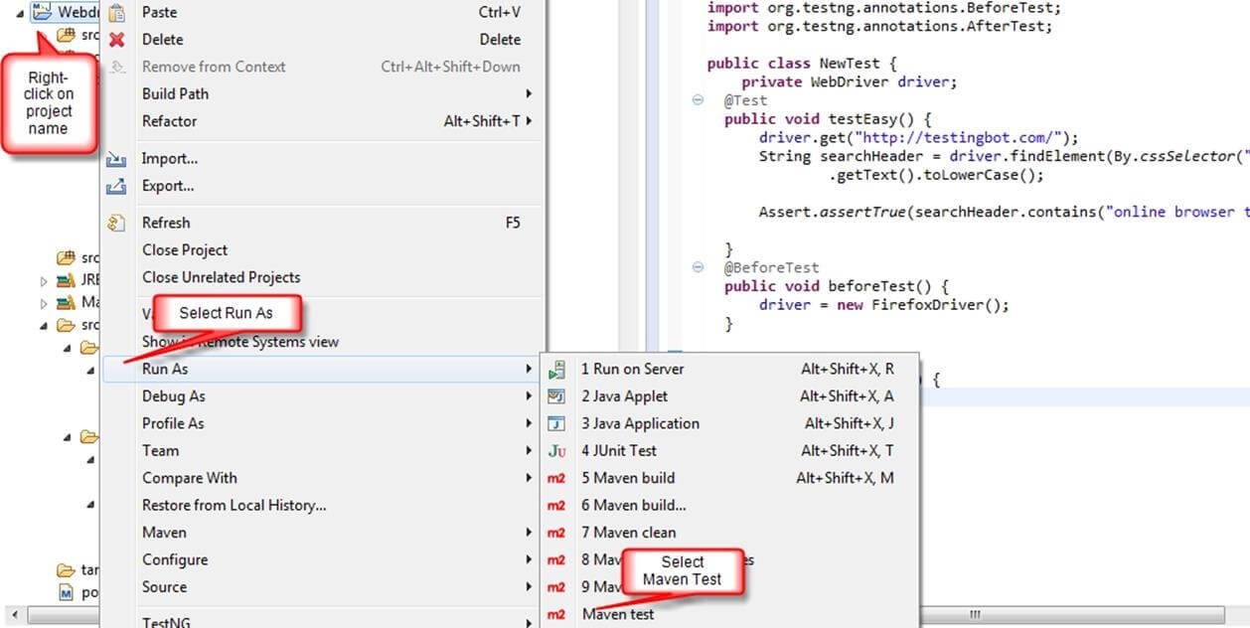
Step 15)To run the tests in the Maven lifecycle, Right-click on the Webdriver
Test and select Run As | Maven test. Maven will execute test from the project.

Slide 16
Covered Till Now
Maven is used to define project structure, dependencies, build, and test management.
Using pom.xml(Maven) you can configure dependencies needed for building testing and running code.
Maven automatically downloads the necessary files from the repository while building the project.
Maven Installation and using with TestNG Selenium.

Slide 17
Thanks

